Slide 1

CMSC 137
Data Communications and Networking
Lecture Module
20 – IP Support Protocols

Slide 2
Module 20: IP Support Protocols
Rozano S. Maniaol
Lecturer

Slide 3
Support Protocols

Slide 4
ICMPv4
IPv4 has deficiencies
No error-reporting or error correcting mechanism
Lacks mechanism for host and management queries
Internet Control Message Protocol version 4 (ICMPv4) compensate for the deficiencies, companion protocol to IPv4 [RFC 792]
Error-reporting messages – report problems that a router or a host may encounter when it process an IP packet
Query messages – helps a host get specific information from a router or another host

Slide 5
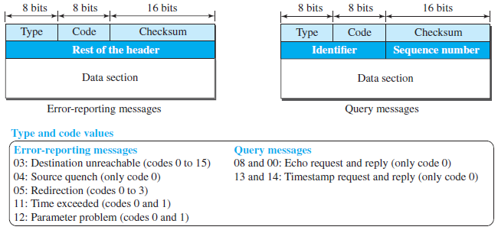
ICMPv4 Format

Slide 6
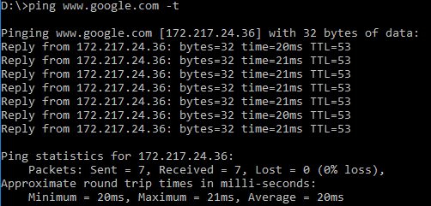
Debugging Tools
ping
  To find if a host is alive and responding
  Can calculate round-trip time

Slide 7
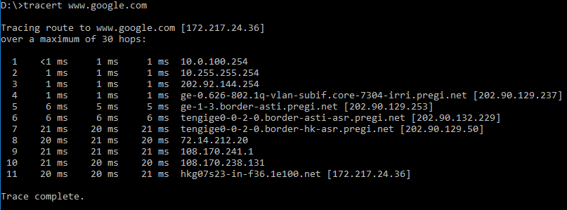
Debugging Tools
traceroute (UNIX) / tracert (Windows)
  Used to trace path of a packet from a source to the destination
  Can find all the IP addresses of all routers that are visited along the path (usually set to 30 hops max)

Slide 8
Address Mapping

Slide 9
Address Mapping
Physical addresses and logical addresses are two different identifiers and are needed both:
  A physical network such as Ethernet can have 2 different protocols at the network layer such as IP and IPX (Novell) at the same time
  A packet at a network layer such as IP may pass through different physical networks such as Ethernet and LocalTalk (Apple)

Slide 10
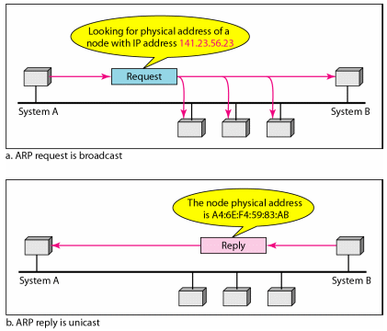
Mapping Logical to Physical Address
Address Resolution Protocol (ARP)

Slide 11
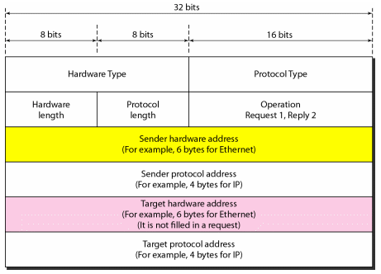
ARP Packet

Slide 12
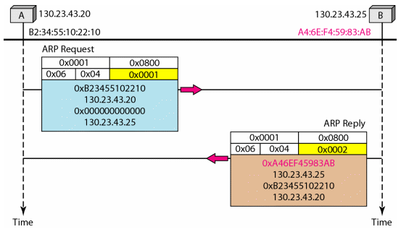
ARP

Slide 13
Mapping Physical to Logical Address
Occasions in which host know its physical address but needs to know its logical address
  A diskless station is booted
  An organization does not have enough IP addresses to assign to each station
RARP, BOOTP and DHCP

Slide 14
RARP
Reverse Address Resolution Protocol
  A RARP request is created and broadcast on the local network
  Another machine on the local network that knows all the IP address will respond to the RARP reply
  Problem: broadcasting is done at the data link layer, it does not pass the boundaries of a network

Slide 15
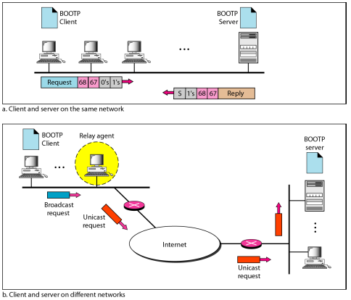
BOOTP
Bootstrap Protocol – application layer protocol used to automatically assign an IP address to network devices from a configuration server
[RFC 951]

Slide 16
DHCP
Dynamic Host Configuration Protocol – provides static and dynamic addresses allocation that can be manual or automatic
Static address allocation – acts as what BOOTP does. DHCP server has a databases that statically binds physical addresses to IP addresses
Dynamic address allocation – DHCP has a second database with pool of available IP addresses

Slide 17
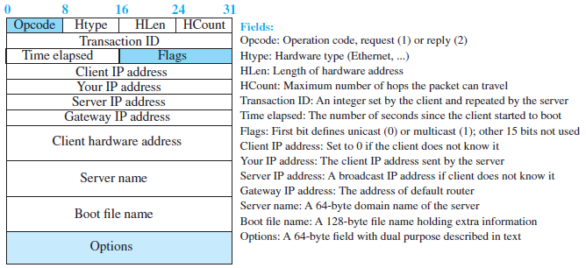
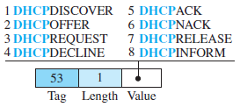
DHCP Message Format
Option format

Slide 18
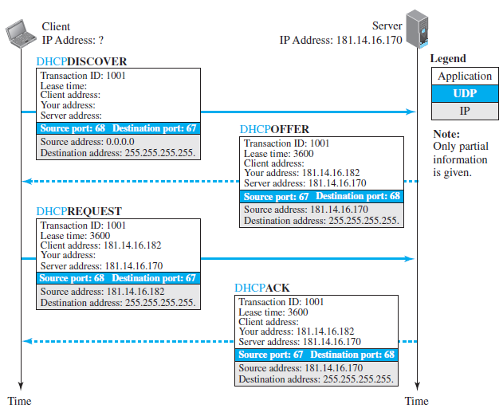
DHCP Message Format

Slide 19
References
Forouzan, B.A. 2013. Data Communications and Networking, 5th Ed. McGraw-Hill, New York.

